Slide 1
Tech Punch
Entity Framework 6
Jean Hibbert.
28 Jan 2016

Slide 2
Agenda
High Level Overview of Entity Framework 6
Core Services
Object Services
Linq Provider
Change Tracker
Db Migrations: update-database | add-migration [Migration Name] | enable-migrations
New(ish) Features
Considering other Micro ORMs
Dapper (static)
Massive (dynamic)
Demo
How to structure a Web Application that uses Repository Pattern
Bench mark tests
Entity Framework 7
Resources

Slide 3
High Level Overview of Entity Framework 6
Object Services
DbContext represents the session of interaction between the applications and the data source. It tracks changes, manages identity, concurrency and relationships
Linq Provider
Exposes IQueryable Interface on DbSet<Entity> Properties exposed on DbContext. Provider was taken from the LinqToSql Linq Provider. See link to Matt Warren’s blog in Resources.
Db Change Tracker
Unit of Work : Maintains a list of objects affected by a business transaction and coordinates the writing out of changes and the resolution of concurrency problems.
Db Migrations
An optional tool that will allow you to drive the evolution of your database schema through your model entities, their attribute metadata and their relationships.
Static data seeding capabilities are available on initial database creation.

Slide 4
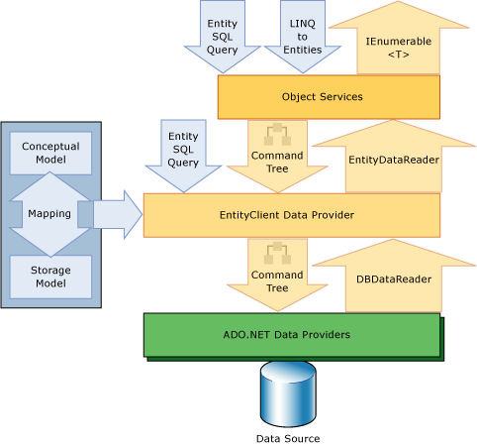
EF Architecture

Slide 5
Entity Framework 6 New(ish) Features
Asynchronous query and save
Connection resiliency
Code based configuration
Database command interception and logging
Code first CRUD stored procedures
Multiple contexts per database
Default transaction level for generated code first DB is now READ_COMMITTED_SNAPSHOT
Enums and spatial support
DbChangeTracker.HasChanges / DbSet.AddRange / DbSet.RemoveRange
Support for a default Schema – DBModelBuilder.HasDefaultSchema
Configurable migrations history table
Connection resiliency
Improved transaction support

Slide 6
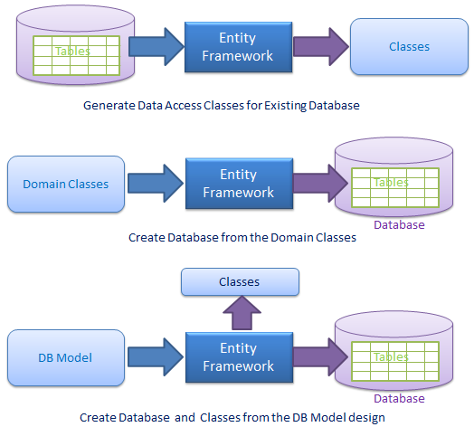
Options with Entity Framework

Slide 7

Considering other Micro ORMs
Dapper (static)
Massive (dynamic)
Advantageous
Speed (serialisation/execution), lightweight, simple to implement
Better control over SQL generated
Disadvantageous
No Linq Provider, Db Migrations, DbChange Tracker features
Need to roll write your own select/insert/update/delete queries. This inline SQL needs to be maintained!!

Slide 8
Show me some code!!!
Create MVC Application from scratch using EF Power Tools
Demo
What patterns do I use for a Web application vs. Thick Client/Windows Service
Repository vs Factory pattern
Performance Tests
Debug Unit Test in EF Open Source Library

Slide 9
Entity Framework 7
Linq Provider improvements
Readable SQL
Multiple Queries for large result sets
SQL Performance
Bulk Inserts
Multiple platforms Unix, Windows Phone etc
Support for non-relational databases
Code first only
Low memory footprint / Pay-per-Play
Support for non-relational DBs

Slide 10
Resources
Entity Framework 6 Open Source
http://entityframework.codeplex.com/
https://entityframework.codeplex.com/wikipage?title=Getting%20and%20Building%20EF%20Runtime
Entity Framework 7 Open Source
https://github.com/aspnet/EntityFramework
Matt Warren’s Blog – How to build a linq provider
http://blogs.msdn.com/b/mattwar/archive/2007/07/30/linq-building-an-iqueryable-provider-part-i.aspx
EF Power Tools
https://visualstudiogallery.msdn.microsoft.com/72a60b14-1581-4b9b-89f2-846072eff19d
EF Patterns / Handling Concurrent Transactions / Advanced scenarios
http://www.asp.net/mvc/overview/getting-started/getting-started-with-ef-using-mvc/handling-concurrency-with-the-entity-framework-in-an-asp-net-mvc-application
http://mehdi.me/ambient-dbcontext-in-ef6/
http://www.asp.net/mvc/overview/getting-started/getting-started-with-ef-using-mvc/advanced-entity-framework-scenarios-for-an-mvc-web-application
Performance Tips
https://msdn.microsoft.com/en-gb/data/hh949853.aspx
http://www.farreachinc.com/blog/far-reach/2013/09/26/entity-framework-query-optimizations
http://www.dotnet-tricks.com/Tutorial/entityframework/J8bO140912-Tips-to-improve-Entity-Framework-Performance.html
Benchmark Demo Code Taken From
https://github.com/FransBouma/RawDataAccessBencher
Rowan Miller and Julie Lerman’s Blog
https://github.com/rowanmiller
http://thedatafarm.com/blog/

